Slide 1
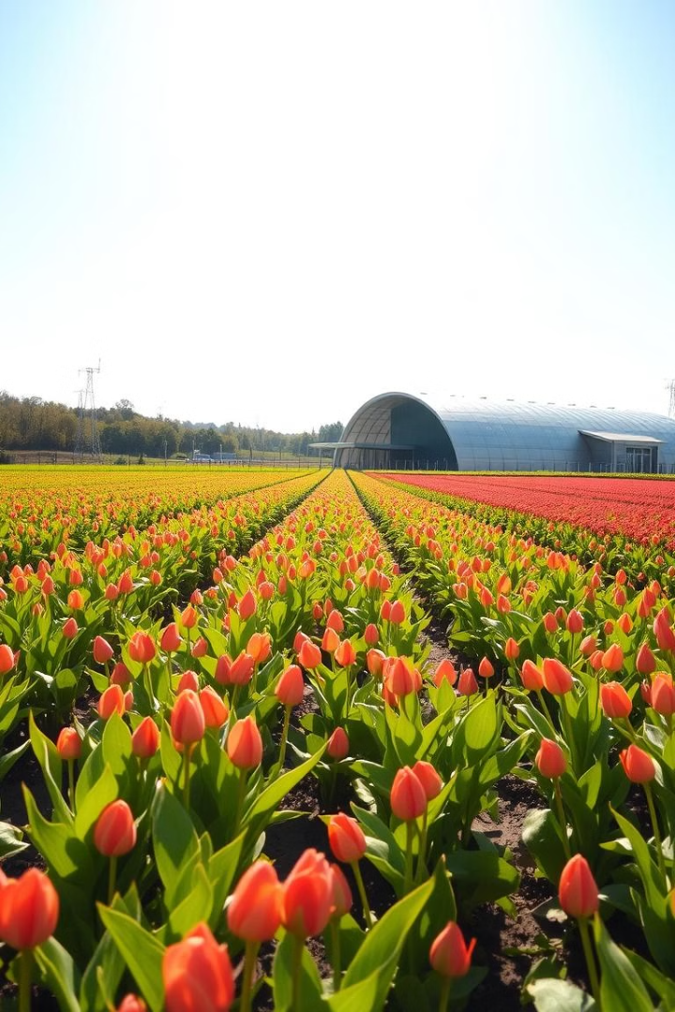
🌱 Sustainable Agriculture & Smart Farming
Welcome! This brochure explores the exciting world of sustainable agriculture and smart farming, highlighting key opportunities for investment and collaboration.

Slide 2
The Growing Need for Sustainable Practices
Rising Food Demand
Climate Change Impact
The global population is growing, putting pressure on food production. Sustainable practices ensure food security for all.
Climate change is affecting agricultural yields. Smart farming adapts to these changes, increasing resilience and efficiency.

Slide 3
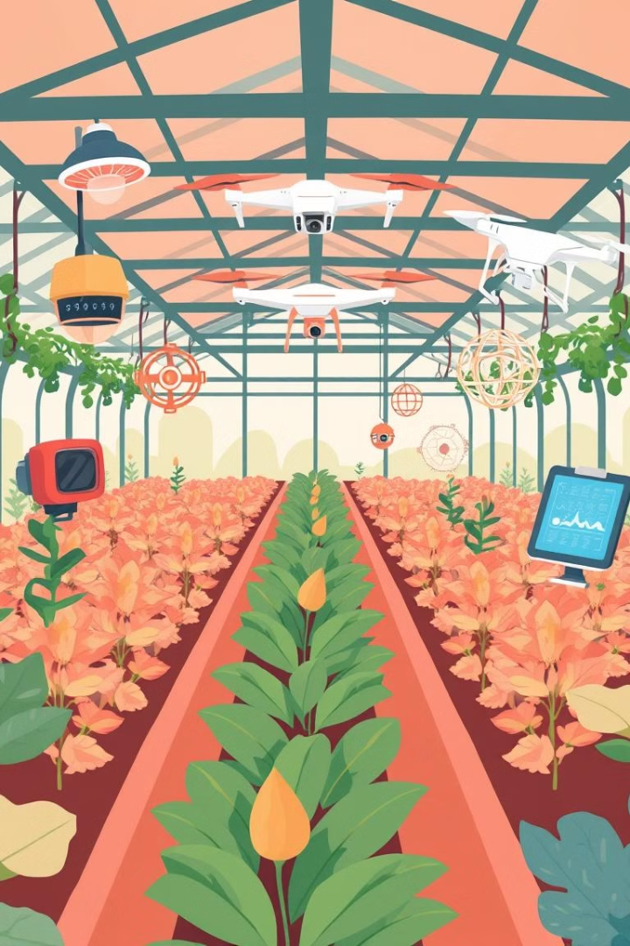
Smart Farming Technologies: Transforming Agriculture
1
Precision Irrigation
2
Precision Fertilization
Sensors monitor soil moisture, delivering water precisely to plants, reducing waste and optimizing water use.
Sensors analyze soil nutrient levels, allowing farmers to apply the right amount of fertilizer, minimizing environmental impact.
3
Crop Monitoring with Drones
Drones capture aerial imagery, providing real-time insights into crop health and growth, enabling early detection of issues.

Slide 4
Harnessing Data for Improved Decision-Making
Yield Optimization
Pest and Disease Management
Analyzing historical data helps predict yields, optimize planting strategies, and improve resource allocation.
Data-driven insights enable proactive measures to prevent pest outbreaks and diseases, minimizing crop loss.
Market Analysis
Data analysis helps farmers understand market trends and optimize production to meet demand, increasing profitability.

Slide 5
The Economic Benefits of Sustainable Agriculture
Increased Efficiency
Enhanced Yields
Premium Prices
Smart farming optimizes resource use, reducing input costs and maximizing profits.
Sustainable practices improve soil health, resulting in higher yields and increased productivity.
Consumers increasingly value sustainably produced food, leading to higher prices for certified products.

Slide 6
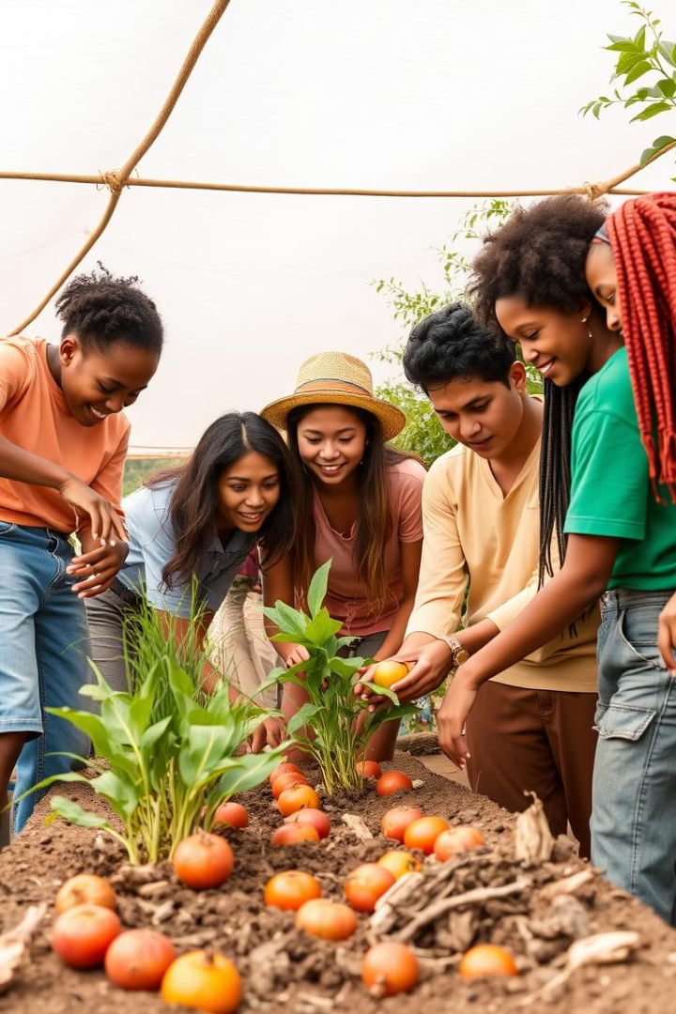
Building a Sustainable Future Together
1
Investment Opportunities
Support innovative startups and companies developing cutting-edge technologies in smart farming.
2
Research and Development
Collaborate with universities and research institutions to advance sustainable agriculture practices.
3
Policy Advocacy
Advocate for policies that encourage sustainable agriculture and support farmers in adopting new technologies.

Slide 7
Let's Partner to Drive Sustainable Growth
Collaborate
Join forces to create innovative solutions for sustainable agriculture and food production.
Invest
Support the development and adoption of smart farming technologies for a more sustainable future.
Advocate
Together, we can shape policies that promote sustainable agriculture and a thriving food system.

Slide 8
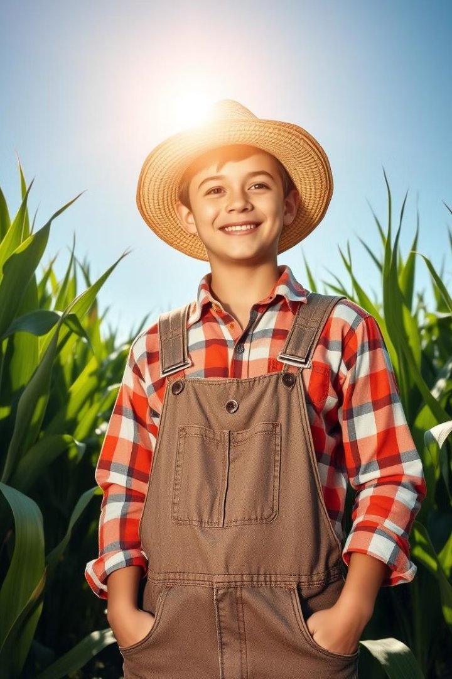
Empowering Farmers, Securing the Future
By embracing sustainable agriculture and smart farming technologies, we can create a brighter future for farmers, consumers, and the planet. Let's work together to build a more sustainable and prosperous food system.

